Slide 1
Testing Because We still haven’t covered it all

Slide 2
Hey john – is there any end in sight?
No
Testing goes on forever!!!

Slide 3
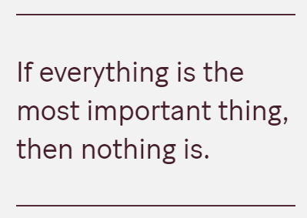
Previously
Concept testing
Unit testing
Boundary testing
Integration testing
Performance testing
System testing
Acceptance and usability testing
Regression testing
https://bdickason.com/posts/speed-is-the-killer-feature/
https://increment.com/reliability/failure-is-okay/

Slide 4
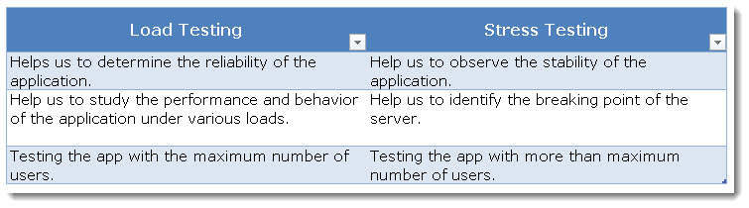
A load test is a planned test to perform a specified number of requests to a system in order to test the functionality of the system under specific levels of simultaneous requests.
A load test ensures that a web system is capable of handling an expected volume of traffic (volume testing)
The goal of a load test is to prove that a system can handle the expected volume with minimal/acceptable performance degradation. The threshold of acceptable performance degradation must be defined by the testers as an agreed value that is considered acceptable to the end user, to ensure a good user experience regardless of the stress/load on the system.
Anyone seen examples of this on busy websites?

Slide 5
A stress test is a test designed to increase the number of simultaneous requests on a system past a point where performance is degraded, possibly even to the point of complete failure.
Where a load test will peak out in the number of simultaneous users, a basic stress test will continue to increase load on the system until the resources are overloaded.
This pushes the system to a state of potential failure to see how the system handles it and whether the system can perform a graceful recovery.

Slide 6


https://netflix.github.io/chaosmonkey/
Research chaos monkey

Slide 7
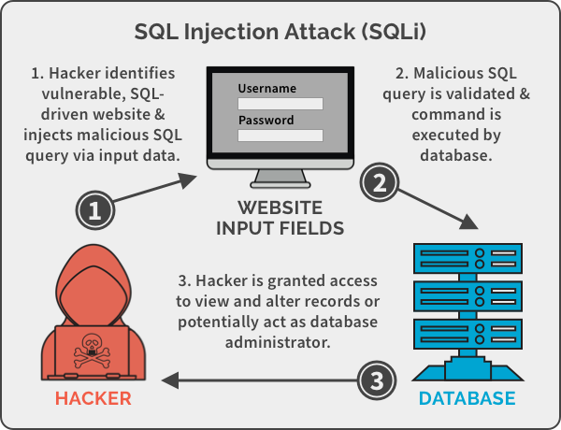
SQL INJECTION
SQL injection attacks are very common
Lets look at an example. If a website allows the user to change their password, the database SQL command may look like this:
If the coder forgets to check the user data is safe. The contents of $pwd or $uid may be compromised by a hacker.

Slide 8
SQL INJECTION
What the website coder thinks will happen:
This SQL command it sent to the database.
If the coder forgets to check the user data is safe. The contents of $pwd or $uid may be compromised by a hacker.

Slide 9
SQL INJECTION
The hacker carefully crafts his new password to be the following string:
Note the position of the quotes and the extra SQL commands entered.
The resulting SQL command now looks like:
' or uid like'%admin%

Slide 10
' or uid like'%admin%
https://www.php.net/manual/en/security.database.sql-injection.php

Slide 11

Covid 19
Computer modelling and testing is at the forefront of the response to Covid-19.
https://www.scientific-computing.com/feature/software-heart-drug-development-covid-19
Mini task:
Read and create a summary map

Slide 12
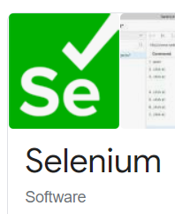
Test automation
Test Automation is the use of software separate from the software being tested to control the execution of tests and the comparison of actual outcomes with predicted outcomes.
Test automation can automate some repetitive but necessary tasks in a formalized testing process already in place, or perform additional testing that would be difficult to do manually.
Test automation is critical for continuous delivery and continuous testing.
Graphical user interface testing: A testing framework that generates user interface events such as keystrokes and mouse clicks, and observes the changes that result in the user interface, to validate that the observable behaviour of the program is correct.
API driven testing: A testing framework that uses a programming interface to the application to validate the behaviour under test. Typically API driven testing bypasses application user interface altogether. It can also be testing public (usually) interfaces to classes, modules or libraries are tested with a variety of input arguments to validate that the results that are returned are correct.

Slide 13
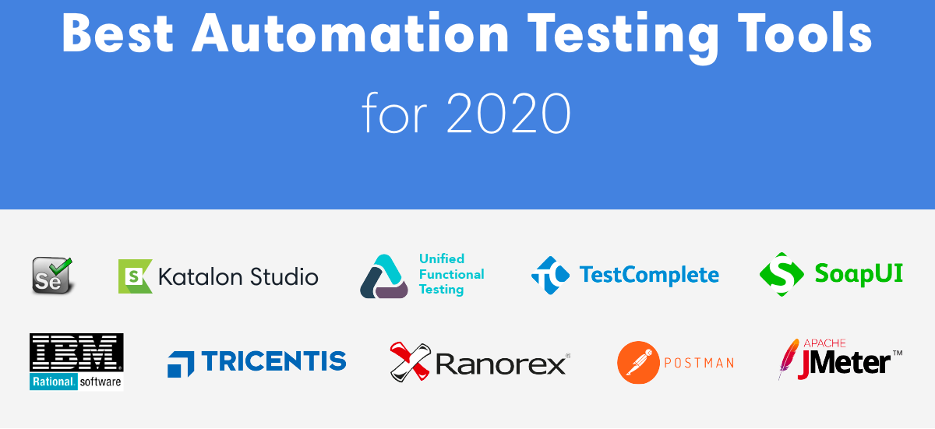
https://www.softwaretestinghelp.com/top-20-automation-testing-tools/
Pairs. Take a tool and investigate it (all tools to be covered)
Summarise and tell the class what you found out – 1 slide of powerpoint
2 case studies of tool use – 1 slide of powerpoint
25 – 30 minutes

Slide 14
Performance testing
Performance testing is a type of testing for determining the speed of a computer, network or device.
E.g. website, API, online game
It checks the performance of the components of a system by passing different parameters in different load scenarios.

Slide 15
Performance testing
Performance testing is split into two:
Load testing
Stress testing
Load testing is the process that simulates actual user load on any application or website. It checks how the application behaves during normal and high loads. This type of testing is applied when a development project nears to its completion.
Stress testing is a type of testing that determines the stability and robustness of the system. It is a non-functional testing technique. This testing technique uses auto-generated simulation model that checks all the hypothetical scenarios.

Slide 16
Load testing
Find the upper limit of the system
Test heavy load
Peak performance – server quality and response times
Do not break the system
What will you find?
Buffer overflow errors, out of memory, network choking
Examples
Lots of data in a word processor
10s of 1,000s of users buying on Black Friday

Slide 17
Stress testing
Extreme load
Failure recovery
Stability and response times
Beyond the threshold of a break
What sort of tests?
Shut down parts of a network
Fill a database hard drive
What would you look for? What would a test pass look like?
If half the network is down all data is saved
Security is not compromised

Slide 18
tasks
Carry on with your revision notes.
Ensure all points covered today are in your notes.
RESEARCH!! Research current threats and how companies mitigate those threats.
https://www.cloudflare.com/en-gb/ddos/
https://aws.amazon.com/solutions/implementations/distributed-load-testing-on-aws/
https://solutionspace.blog/2022/06/18/map-data-v-false-assumptions-programmers-make/

